Slide 1
Routing basics
Hardeep Kaur Dhalla

Slide 2
Using Angular routes in a SPAs
Render only the relevant part to the user, instead of loading a new page.
This will significantly improve your application's user experience.
We can add routing to define how users navigate from one part of application to another.

Slide 3
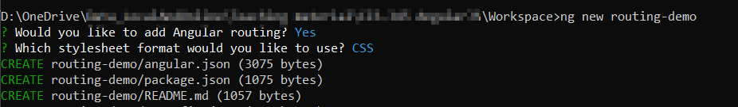
Create a new project with routing enabled
By default, app-routing.module.ts file will be created after using ng command.

Slide 4
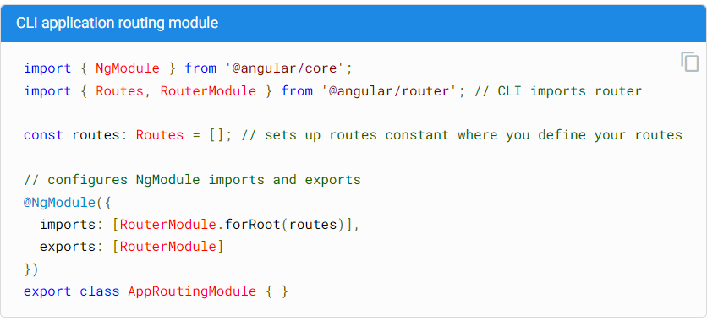
app-routing.module.ts file
By default, app-routing.module.ts file will be created after using ng command.

Slide 5
Define your routes
A route definition is a JavaScript object.
Each route typically has two properties:
path- string that specifies the URL path for the route
Component - string that specifies what component your application should display for that path.

Slide 6
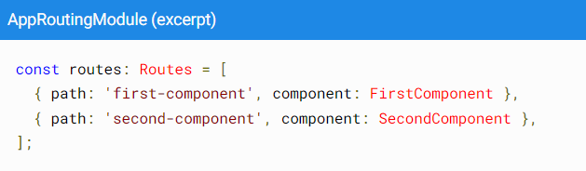
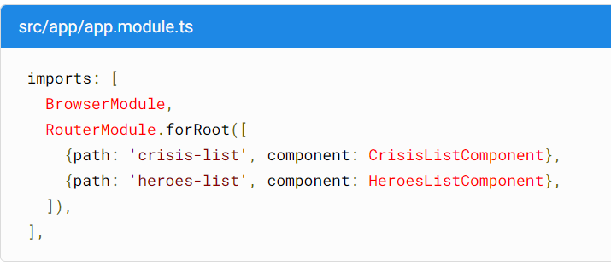
Define your routes
1st approach
2nd approach

Slide 7
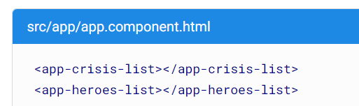
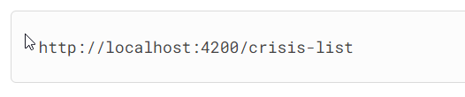
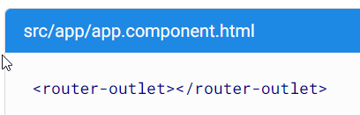
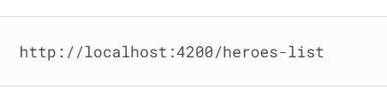
Router-outlet directive
For your routes to work, you need to update your template to dynamically load a component based on the URL path.
Let us not hard code components name in the html template.
Remove it
This directive will display the active component

Slide 8
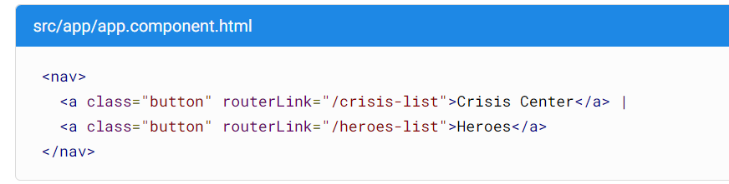
Control navigation with UI elements
This HTML uses an Angular directive, “routerLink” instead of “href” attribute.
This directive connects the routes you defined to your template files.
This will make sure application is not reloading again and you will not lose app state data.

Slide 9
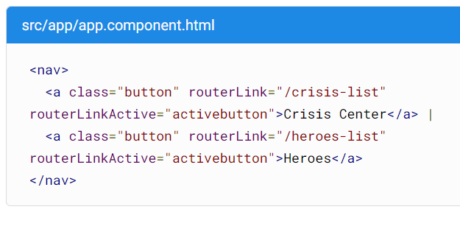
Identify the active route
Add this functionality using Angular's routerLinkActive directive.
This way you can style active link differently.
activebutton is a CSS class.

Slide 10
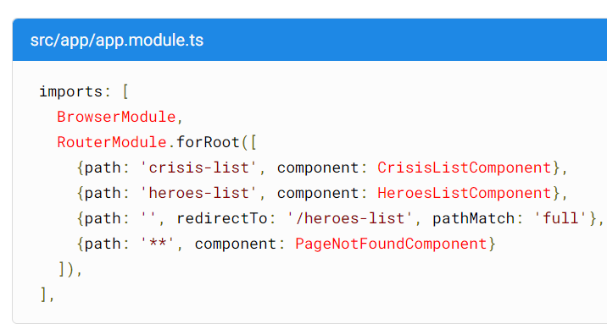
Redirect and page not found routes
Empty string – by default heroes-list component will be displayed.
** - Any route that does not match an existing route in your configuration will use this route.

Slide 11
Route order
The Router uses a first-match wins strategy.
More specific routes should be placed above less specific routes.
List routes with a static path first, followed by an empty path route, which matches the default route.
The wildcard route comes last because it matches every URL and the Router selects it only if no other routes match first.

Slide 12
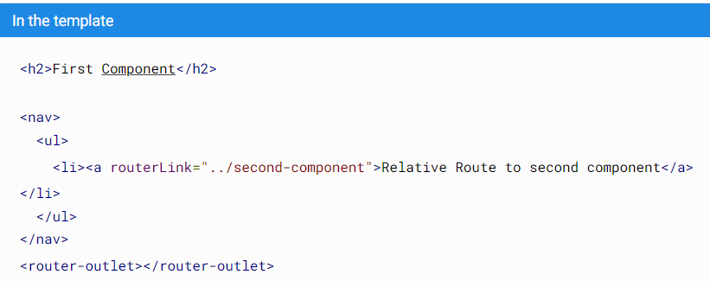
Relative paths
Relative paths let you define paths that are relative to the current URL segment.
FirstComponent and SecondComponent are at the same level in the tree.
use ./ or no leading slash to specify the current level.

Slide 13
Absolute paths
Use forward slash / to make it an absolute path.
If the first segment begins with /, the router looks up the route from the root of the app - localhost/4200.

Slide 14
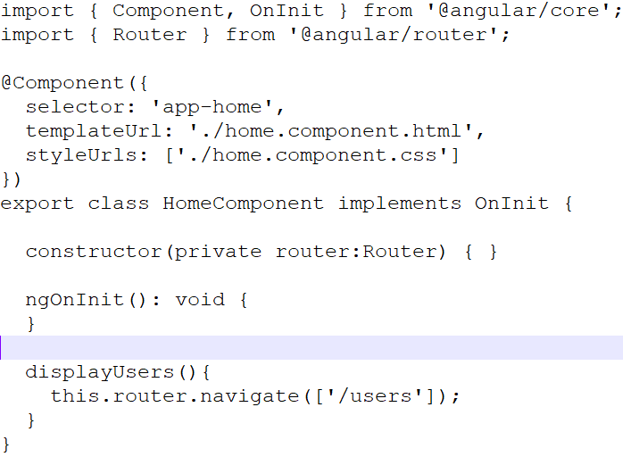
Navigate method
You can dynamically change routes in your application. For example: on a button click, navigate from Home to Users component.

Slide 15
Passing route parameters to routes
You can pass parameters to path using colon : and then name of the parameter.
{path:’users/:id’,component:UsersComponent}
Value for id can be any.
http://localhost:4200/users/2
http://localhost:4200/users/awesome
Passing more than one param
{path:’users/:id/:name’,component:UsersComponent}

Slide 16
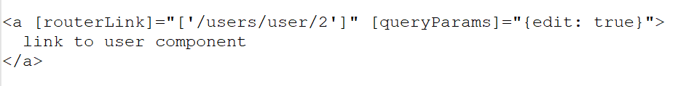
Passing query params
http://localhost:4200/users/2?edit=true
Setting and handling query params
This path will resolve to /users/user/2?debug=true

Slide 17

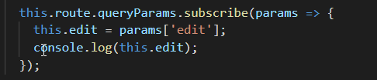
Getting route information
We can use ActivatedRoute class to get this information.

Slide 18
References
https://angular.io/guide/router#common-routing-tasks
https://angular.io/api/router/RouterLink#description

